Slide 1
NEW TRAINING PROGRAM ON ENTREPRENEURSHIP
OURENSE, NOVEMBER?? 2020

Slide 2

TRAINING PROGRAM MOTIVATION
The society, the economy and the business world have changed in recent years.
Re-valuation of the social image of the entrepreneur and women empowerment.
Public effort to create business policies as a mechanism to combat unemployment.
This Training Program aims to support female entrepreneurs

Slide 3
COMPETENCES OF THE TRAINING PROGRAM
Evaluate the entrepreneur's profile in relation to her business idea.
Think about the business alternative: the activity sector and its evolution, commercial and technical information, current regulations, entry barriers ...
Realize the analysis of the environment.
Analyze competitive advantages by performing a SWOT analysis.
Decide the optimal size of the business.

Slide 4
MAIN OBJECTIVE
Provide a simple practical and operational methodology that allows women entrepreneurs to lead business initiatives.
Carry out the planning and implementation of strategies of the different business areas to guarantee the achievement of their business objectives.

Slide 5
SPECIFIC OBJECTIVES
Plan the activities to be undertaken, identify and evaluate different business opportunities
Manage people, organize and control material resources.
Develop the marketing and sale of products and services.
Manage the obtaining of financial resources by negotiating the conditions and selecting the most suitable product.
Integrate the analysed and planned elements into the business plan.

Slide 6
TRAINING PROGRAM
MODULE 1: START UP OF THE ENTREPRENEURSHIP PROJECT
MODULE 2: HUMAN RESOURCES MANAGEMENT
MODULE 3: MARKETING/COMMERCIAL MANAGEMENT
MODULE 4: ECONOMIC-FINANCIAL MANAGEMENT
MODULE 5: BUSINESS PLAN

Slide 7
Módulo 1:
START UP OF THE ENTREPRENEURSHIP PROJECT

Slide 8
MODULE 1: START UP OF THE ENTREPRENEURSHIP PROJECT
THE ENTREPRENEUR
DEVELOPMENT OF THE BUSINESS IDEA
STUDY OF THE GENERAL AND SPECIFIC ENVIRONMENT
LEGAL FRAMEWORK
COMPANY ORGANIZATION: PRODUCT, PROCESSES AND RESOURCES
SWOT ANALYSIS
FIRST APPROACH TO THE BUSINESS PLAN

Slide 9

ENTREPRENEUR'S PROFILE
Commitment
Constancy
Perseverance
Deal of effort
Enthusiasm

Slide 10

BUSINESS IDEA
Generation and analysis of business idea
What?
Whom?
When?
How?
Where?
Maturing the SCAMPER idea
Specifying the necessary elements to develop the business plan

Slide 11
WHAT?
a) the balance of value
b) the list of attributes
c) S.C.A.M.P.E.R
Substitute
Combine
Adapt
Modify
Put on other uses
Eliminate
Reverse

Slide 12

A) VALUE
Value is the benefit or utility that can be obtained from a good and / or service.
The value of a soft drink is to quench your thirst.
The value is not in the good or service itself, but the experience derived from it.
If VALUE <CONTRIBUTION. WE ARE NOT INTERESTED
Take a taxi.
Value: No Parking, no street ...
Contribution: Race payment, locate taxi ..

Slide 13
B) ATTRIBUTES(CRAWFORD, 1954)
The attributes of a product, service or process are identified, in order to consider each one as a source of modification and improvement.
The procedure is:
Identify the product, service or process to improve or the problem to solve.
Analyze it and make a list of as many attributes as possible.
Select each attribute and think about how to change or improve it. For each attribute a SCAMPER could be made.

Slide 14
C) S.C.A.M.P.E.R. (TECHNIQUE FOR CREATIVE THINKING)
The name SCAMPER is acronym for seven techniques:
(S) Substitute
(C) Combine
(A) Adapt
(M) Modify
(P) Put to another use
(E) Eliminate
(R) Reverse.
These keywords represent the necessary questions addressed during the creative thinking meeting.

Slide 15
WORKED EXAMPLE OF S.C.A.M.P.E.R.
Substitute: What can be replaced? (e.g., components, materials, people)
If you make bicycles, you could substitute aluminum for carbon fiber (because of the weight).
Combine: What can be combined? (e.g. other features, devices)
Smartphones have combined telephone with cameras.
Adapt: What can be added? (as new elements or functions)
Now cars have built-in wifi.
Modify: What can be modified? (e.g., change the size, shape, color…)
Reduced size sunglasses for babies or young children.

Slide 16
Put to another use: Could you put the product to a different use, or use it in another industry?
During the COVID19 pandemic, coffee filters were used as filters in face masks.
Eliminate: What can be eliminated or simplified?
Remove the car lighters to be able to use the space for the charging devices.
Reverse: What can be changed or turned around?
Fast food restaurants rearranged the typical eating-then-pay-to-pay-then-eat model.

Slide 17
WHOM?
Age / Sex
Way of life
Leisure / work habits / needs / wants
Purchasing power / education
Product loyalty / brand loyalty
Purpose of purchase

Slide 18
WHEN?
Frequency
Seasonality
Regularity
Emergency
Time spent
Product life phase

Slide 19
HOW OFFERING?
Packaging
Packing
Alone or together
There is a minimum
Price and promotions
Way to publicize the product

Slide 20
WHERE OFFERING?
What place
How we do get to the customer
Logistical possibilities
Synergies possibilities
Importance of our company in the market (strategic group)

Slide 21
FIRST ASSESSMENT
FROM ALL THIS POINTS, DERIVE:
ASSESSMENT
Technical viability- Can be done?
Economic viability- Can you earn money?
Financial viability- Is it possible to get the money?

Slide 22


Worked example of first assessment
Considering the current pandemic situation, Anne is thinking of setting up a small workshop for the manufacture of surgical masks. Make a first assessment of the project
Several companies supply this type of machinery.
E.g. Cera-Groupecera.
Technical viability
Is technology available?
Strict rules must be followed for its preparation and approval.
Is it allowed by law?

Slide 23
I have savings.
My project is viable and, therefore, I could get financing through financial institutions.
Financial viability
Will I be able to get the necessary financing?
Economic viability
Will it generate a return?
The expected income will exceed the costs.

Slide 24
1ST ANALYSIS OF THE ENVIRONMENT
GENERAL
ENVIRONMENT
SPECIFIC
ENVIRONMENT
POLITICAL
COMPETITORS
ECONOMIC
CUSTOMERS
SOCIAL
SUPPLIERS
TECHNOLOGICAL
PRESSURE GROUPS

Slide 25

THE GENERAL ENVIRONMENT OF THE COMPANY
The general environment in which a company operates is set of factors of an economic, political-regulatory, socio-cultural and technological nature that affects, or may affect, its activity to that of its customers or suppliers, that of its competitors, etc.

Slide 26
SPECIFIC ENVIRONMENT
Suppliers
Customers
Competitors
Pressure groups

Slide 27
THE SPECIFIC SCOPE OF THE COMPANY: SUPPLIERS
It is necessary to select the suppliers that meet the most suitable qualities based on:
Technical qualification and quality of your products
Prices and payment terms
Delivery times and seriousness in complying with the agreement.
If they are potential competitors (“integrated face-to-face”)

Slide 28

THE SPECIFIC SCOPE OF THE COMPANY: CUSTOMERS
It is necessary to study the market
we are targeting
How big is that market?
Who is our potential client and what is their profile?
Why do potential customers need our product?
How do you make people realize they need it?
How will we reach our potential clients?

Slide 29

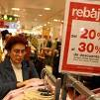

THE SPECIFIC SCOPE OF THE COMPANY
What
PRICE
What PRODUCT
Why?
Who?
COMPETITORS
competitors also reach our customers
MARKET SEGMENT

Slide 30

THE SPECIFIC SCOPE OF THE COMPANY: CUSTOMERS
We need to estimate the size of the market for which we will define:
The geographic market: areas where the product or service will be offered
The target market: specific market segments we are going to target
The market situation: current state and possible evolution of our market and the market in general
The profile of our potential client.

Slide 31
THE SPECIFIC SCOPE OF THE COMPANY: CUSTOMERS
Customer profile
is the set of personal characteristics of the final consumer of the product or service.
The objectification of the market allows to describe very clearly the best client.
A high percentage of customers will only satisfy part of this profile: they constitute our secondary market.
The motivations and purchasing mechanisms
Their needs
Their perceptions
Their motivations
Their attitudes
What should we know about the client?

Slide 32
THE SPECIFIC SCOPE OF THE COMPANY: COMPETITORS
To determining the number and characteristics of competitors
Their weak and strong points in relation to our project should be analyzed.
Outlook
Dimension
Human resources available
Geographical area of influence
Structure
Degree of implantation in the market, etc.
In the case of new markets, the competition will be that it is currently satisfying the needs of our potential customers through substitute products/services.

Slide 33
THE SPECIFIC SCOPE OF THE COMPANY: COMPETITORS
The basic strategies to position a product or service in the market are:
Cost Leadership: Cost leadership strives towards cutting costs to a minimum possible levels in order to provide customers with lower prices and thus boost their savings.
Differentiation: involves choosing a market niche in which competition is less or zero.

Slide 34
THE SPECIFIC SCOPE OF THE COMPANY: COMPETITORS
This differentiation requires the development of skills such as
Knowledge of certain technologies
Relations with certain agents in the target market
Knowledge of a process
Access to a distribution channel
The aspects on which the development of differentiation strategies could be feasible can be:
Better quality of the product / service perceived by the customer
Improvements in delivery times
A more efficient after-sales service appreciated by the client.
Lean technical documentation

Slide 35


Real examples
IKEA's competitive advantage is based on its cost leadership over its competitors, based largely on the idea that the "customer can assemble their own furniture" and the location of its stores on the outskirts of cities.
Harley Davidson's main competitive advantage is its brand image. The manufacturer manages to create an emotional bond with its customers, so that they identify with "freedom", "adventure" and "gregariousness".

Slide 36
THE SPECIFIC SCOPE OF THE COMPANY: COMPETITORS
The degree of rivalry between competitors will depend on the type of maturity of the market and its competitive strategy.
Growth markets are often less competitive (less rivalry).
Saturated markets tend to be more competitive. They often lead to price struggles.
Rivalry occurs because one or more competitors feel pressure or see an opportunity to improve their position

Slide 37
THE SPECIFIC SCOPE OF THE COMPANY: COMPETITORS
Entry and exit barriers
Entry barriers are mechanisms that hinders or completely prevents the entry of new competitors in the market.
Scale economics
High investments
Administrative authorizations
Property industries, patents, etc.

Slide 38
LEGAL FRAMEWORK
Formal Legal Plan
From reflection on:
Number of partners
Business activity
Economic demands
Partner liability
Taxation mode
The type of company is decided

Slide 39
FIRST PROGRESS OF THE PROJECT
RESOURCES
PROCESS
PRODUCT

Slide 40
PRODUCT OR SERVICE
WHAT I AM GOING TO SELL?

Slide 41
PROCESSES
How do we plan to do things?
How we are going to design it
How are we going to sell it
How we are going to provision ourselves
How we are going to manufacture it
How we are going to distribute it

Slide 42
RESOURCES
Tangibles, easily identifiable because they tend to be susceptible to valuation balance: financial resources, facilities, software, storage, etc.
Intangibles rarely appear on the balance sheet: organizational structure, business culture, technology, management team, etc.
Often, the latter better explain the competitive position of the company
THE HUMAN TEAM IS THE FUNDAMENTAL ELEMENT OF THE COMPANY.

Slide 43
TECHNICAL OR FINANCIAL RESOURCES
They are the ways (real estate, machinery, furniture, patents, software, raw materials, etc.) that the company needs to carry out its activity.
As this set of investments must be financed, financing needs are considered.
MUST BE THE ESSENTIAL MINIMUMS.
In addition, the resource needs must be precisely known: Equipment, materials and raw materials and phases of the process to be subcontracted.

Slide 44

INFORMATION SYSTEMS AND COMMUNICATIONS
Accelerated development of new information technologies, which became a fundamental key to maintaining the competitiveness of companies.
Information is a resource that circulates throughout the company.
The information system is the set of processes that collect, prepare, store and distribute the information necessary to carry out the operations of a company and the administrative activities of planning, organization, execution and control, facilitating decision-making for the performance of different functions of the company according to its strategy.

Slide 45

FINANCIAL RESOURCES
The financial resources, which will be contributed by the promoters, by external lenders (such as banks or providers) or come from subsidies of any kind, must be sufficient to:
Address fixed and current investments that are deemed necessary (and always minimal)
Address the possible losses collected, where appropriate, by the Business Plan.
Address possible unforeseen or reasonable deviations from the Business Plan

Slide 46
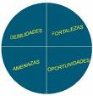
SWOT ANALYSIS
The SWOT is a technique that tries to identify which are the threats for the company that is in its field, to flee from them, and what are the opportunities that it offers, in order to take advantage of them.
Likewise, it asks about the company's strengths in relation to that area, to exploit them to the fullest, and their weaknesses, to correct or avoid them, if this is possible.
It tries to converge -the global analysis of the scope-general scope, customers, competitors, etc.-with the functional analysis -internal- of the company.

Slide 47
SWOT ANALYSIS
STRENGTHS
(COMPANY POSITIVE POINTS)
WEAKNESSES
(COMPANY NEGATIVE POINTS)
OPPORTUNITIES
(SECTOR POSITIVE POINTS)
THREATS
(SECTOR NEGATIVE POINTS)

Slide 48

FINAL PRODUCT MODULE 1
FIRST APPROACH TO A BUSINESS PLAN
TO BE REVIEWED AT THE BEGINNING OF SESSION 2

Slide 49
THE BUSINESS PLAN
Executive Summary
The entrepreneur
Products and services
The market
Market research
Market strategy
Competitor analysis
Operations and logistics
Costs and pricing strategy
Financial forecasts

Slide 50
Módulo 2:
HUMAN RESOURCES MANAGEMENT

Slide 51
MODULE 2: HUMAN RESOURCES MANAGEMENT
FUNCTIONS OF THE DEPARTMENT OF HUMAN RESOURCES
EXTERNALIZE SERVICES
ORGANIZATION OF WORK AND ORGANIZATIONAL STRUCTURE
COMMUNICATION AND MOTIVATION
LEADERSHIP AND TEAMWORK
TALENT MANAGEMENT

Slide 52
FUNCTIONS OF THE HR DEPARTMENT
Direct, organize, coordinate, pay and study the activities of the workers of a company.
The functions carried out in an HR Department vary depending on the activity and size of the company.
Among others, it develops the following functions:
Staff selection process
Performance evaluation.
Risks prevention.

Slide 53
SELECTION PROCESS
Analysis of the job
Identification of obligations of the job
Identification of the knowledge, skills and abilities for the job
integration of results and decision making
Application of evaluation elements
Choice of assessment instruments

Slide 54

SELECTION TOOLS
Three basic categories:
The ads: daily press, specialized employment portals, company website, RRSS ...
Direct search: "Head hunt" or "search for research".
Combined method

Slide 55
SELECTION MODELS
Two personnel selection models: Traditional selection model: is based on productive stability in the economic and labour market; seeks knowledge and extensive experience in the position he will develop.
The instruments used are mainly: curriculum vitae, interview and references. Strategic selection model: it is based on a vision of rapid changes in the economic and labour market, values issues such as learning capacity, innovation, creativity, the ability to work as a team, adaptation and flexibility, among others.
The instruments used in this model are: overall mental skill test, personality inventories, simulations...

Slide 56
PERFORMANCE EVALUATION
Continuous and systematic process that aims to make a quantitative and qualitative estimate of the degree of efficiency with which workers carry out their activities.
Companies will evaluate their workers based on a series of criteria:
Key performance indicators. They represent the objectives and goals to be achieved by each employee.
Competences and responsibilities. In terms of knowledge and behaviors expected and required for the job.
Global appraisals. Opinions or appreciations of the direct superior of the worker to be evaluated.

Slide 57
RISKS PREVENTION
Companies must take care of and promote the health of workers.
The ultimate goal of risk prevention is to guarantee the safety and health of workers.
The prevention of professional risks must be integrated at all levels of the company.

Slide 58
OUTSOURCING
Outsourcing can be defined as a subcontracting process in which the management of certain services is entrusted to another company.
Advantage:
Cost reduction
Greater productivity by delegating to specialized professionals.
Disadvantages:
Lost of control
More difficult coordination

Slide 59

WORK ORGANIZATION AND ORGANIZATIONAL STRUCTURE
The work organization aims to coordinate all the means of the company to achieve maximum efficiency.
Nowadays, specialization is essential to achieve greater efficiency.

Slide 60
The entrepreneur must know this clearly:
The business model you want, the goals you want to achieve, the means available to them.
In addition, it must involve its employees in:
The analysis of situations, decision-making, the application of them, achieving the objectives assigned to each.

Slide 61
Collaborators must.
Keeping an eye on the market. Having enough delegated authority to make many accountability decisions. Establish a motivated and integrated team. Delegate to their collaborators, motivating them and taking responsibility for their respective tasks. Have an interest in pursuing an excellent career and having clear promotion possibilities.

Slide 62
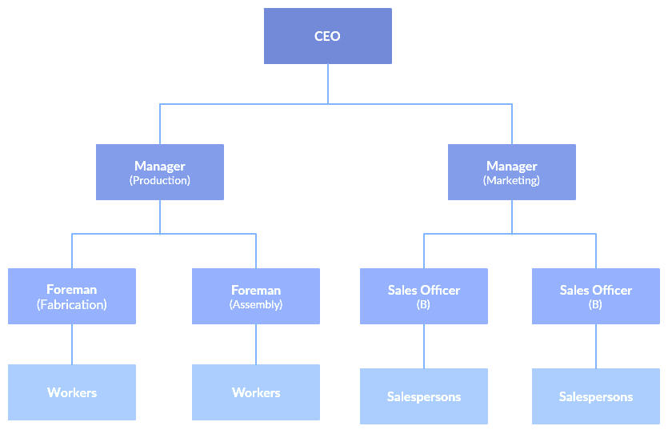
ORGANIZATIONAL STRUCTURE
The organizational structure of a company is the way in which the company is going to be managed. The formal structure is represented by an organization chart.

Slide 63
COMMUNICATION AND MOTIVATION
We define organizational communication’ as the sending and receiving of messages among interrelated individuals within a particular environment or setting to achieve individual and common goals. Organizational communication is highly contextual and culturally dependent.
Advantage:
Increase efficiency
Minimize the buzz
Positive internal climate

Slide 64
MOTIVATION
Motivation is made up of all the factors capable of provoking, maintaining and directing behavior towards a specific objective.
Motivation can be external or internal.
The external comes from the outside “they motivate me” or “they don't motivate me”.
The internal comes from the subject himself.

Slide 65
LEADERSHIP AND TEAMWORK
A leader is a guide who leads his team towards the achievement of the objectives.
Willing, being able and knowing how to be a leader
Motivator
Work ethic
Create high-performance teams
Positive attitude
Know how to listen
Manage conflict
Personal skills
Social skills
Self-confidence
Interactive problem solving
Teamwork
Lead change
Motivator
Visionary
Implement everything learned

Slide 66
TEAMWORK
Activity that, due to its complexity, requires the participation of different people, which implies sharing skills, abilities and knowledge.
Leadership
Communication
Coordination

Slide 67
Módulo 3:
MARKETING/COMMERCIAL MANAGEMENT

Slide 68
MODULE 3: MARKETING/COMMERCIAL MANAGEMENT
Determine the products/services to be offered by detailing their attributes Set and revise pricing policy considering costs, competitive prices, profit margin, product lifecycle, market trend. Choose distribution channels: direct selling, vending, Internet, others Plan strategic communication actions – advertising, promotional campaigns, merchandising actions, others.

Slide 69
MODULE 3: MARKETING/COMMERCIAL MANAGEMENT
Product portfolio determination Strategic price management: Objectives and methods for pricing. Marketing channels. Access to the channel and the sales network. Communication and business image Customer service and loyalty Monitoring and control of the degree of customer satisfaction. Customer's complaints

Slide 70
MODULE 3: MARKETING/COMMERCIAL MANAGEMENT
PRODUCT
(CLEARLY DEFINE WHAT I SELL)
PRICE
(HOW MUCH IS THE CUSTOMER WILLING TO PAY)
PLACE
(LOCATION AND DISTRIBUTION)
PROMOTION
(HOW DO I BRING THE PRODUCT TO THE CUSTOMER)

Slide 71

PRODUCT POLICY
Products and services offered
Quality
Product range and its life cycle
Design and R&D process

Slide 72
PRODUCTS AND SERVICES
In order to determine the suitability of the goods and services, it is necessary to:
Define the need for the market and how it is satisfied. Presenting the good or service to be produced or sold
Highlighting the innovative aspects of good or service
Highlighting the fundamental factors of differentiation Indicate the actions to be carried out for the protection of ideas (patents…)

Slide 73
PRODUCTS AND SERVICES
Identify the main attributes of the product
Formulation of a differentiation strategy:
select product positioning relative to selected attributes select a group of customers ensure compatibility between product attributes and group preferences solved Assess the potential benefit considering the expected returns of the implementation of the differentiation strategy and the cost of such differentiation.
What needs does the product fulfill?
PRODUCT
Identify customer preference patterns related to individual attributes and combination of attributes
What criteria do they follow to choose?
Identify the award that attributes can demand
CUSTOMERS
What are the influences and motivations that determine their behavior?
Identify demographic, psychological, and socioeconomic factors that can explain behavior

Slide 74
QUALITY IN PRODUCTS AND SERVICES
It is one of the critical factors of success for any company. Definitions:
Compliance with specifications or compliance with requirements (Crosby). A noticeable degree of uniformity and reliability at low cost and appropriate to customer needs (Deming). Continuous improvement (Kaizen). Suitability or fitness for use (Juran). Set of planned and systematic actions needed to provide adjusted confidence that a product or service will meet established quality requirements (ISO). ISO guarantees to find what is expected in the "same way".
As a common factor,
quality should be understood as QUALITY PERCEIVED by the customer

Slide 75



QUALITY
Quality is the responsibility of everyone in the company
Quality is achieved through an appropriate manufacturing or service delivery process
Quality should be taken care of during post-product treatments: handling, packaging, transportation, etc.

Slide 76
PRODUCT PORTFOLIO
The diversity of the product/service portfolio can be considered to help a company reduce its risk, as the failure of some can be compensated for by the success of others.
However, a highly diversified company causes problems of dispersion of efforts and resources (both economic, human and financial), control, etc.
The entrepreneur must strike an appropriate balance between the two aspects.

Slide 77
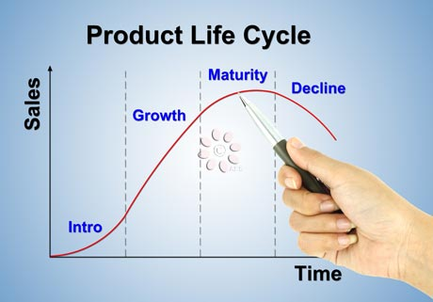
THE PRODUCT LIFE CYCLE
The increase in competition is shortening, forcing a permanent concern about its renewal

Slide 78

THE DESIGN AND R&D PROCESS
Long-term survival lies in the capacity for innovation
As competition increases and benefits are reduced, new differentiating features must be created.
Reducing the life cycle of products requires a permanent concern about their replacement and improvement.
Innovative activity and market orientation depend on the possibilities of keeping a company alive in it.

Slide 79
THE DESIGN AND R&D PROCESS
From an internal point of view, the design activity requires knowledge of both the technical and formal requirements of the product and the aspects necessary for its production.
The design of the product or service must be:
Simple (easy to use). Reliable (do not fail). Quality (materials, duration).

Slide 80
BUSINESS STRATEGY
PRODUCT DIFFERENTIATION
Offer something different
COST LEADERSHIP
Offer something cheap
VERY DIFFICULT FOR A SMALL COMPANY TO COMPETE WITH LARGE AREAS

Slide 81
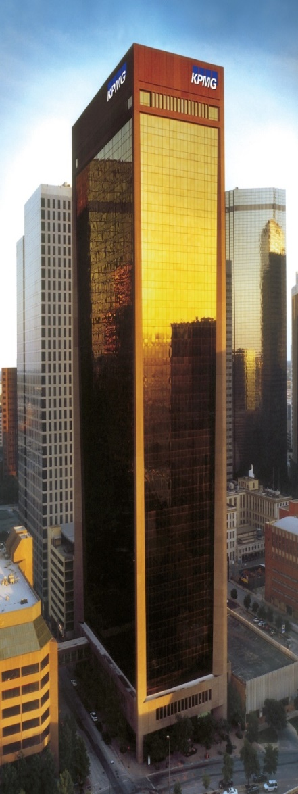
BUSINESS PROCESSES
METHODS for PRICING
Domain situation Markets with the possibility of differentiation Markets with standard products/services
In general, the different methods are typically combined. Each type of company, product or service will require a different pricing policy

Slide 82
PROCESSES
How do we do or plan to do things?
How are we going to design it?
How are we going to sell it?
How are we going to stock up?
How are we going to make it?
How are we going to distribute it?

Slide 83


LOGISTICS PROCESSES
SUPPLY
PRODUCTION
DISTRIBUTION

Slide 84
LOGISTIC PROCESSES
Supply
The necessary materials need to be determined.
Suppliers should be chosen not only on the basis of prices but also by the payment terms offered to us, delivery times, the quality of their products, etc.
Issues such as the average period of permanence of raw materials or goods in the warehouse should be considered, which may condition the financial viability of the Enterprise Project.

Slide 85
LOGISTICS PROCESSES
Production
In the process of preparing the product or service, the following must be:
Describe the activities required to produce the good or provide the service. Organize activities sequentially. Set times.

Slide 86
LOGISTICS PROCESSES
Production
In terms of applied technology, it is important to take into account:
The ease of acquiring it. The special conditions for making use of it: patents, agreements. Special technical aspects (staff capacity, equipment, facilities, etc.). The protection of it and the risk of being copied. The pace of technological innovation in the business field in which our activity is developed. The Financial Standing.

Slide 87
LOGISTICS PROCESSES
Distribution
The distribution channel affects profits, since the more intermediaries, the higher margins are left along the way. The more complex the distribution process, the less control. The main CHANNELS are:
Information technologies are expanding and diversifying the distribution CHANNELS available on the market.
Direct sale by manufacturer or producer Sale through wholesalers Retail sales Sale through commissioners New forms of distribution such as FRANCHISES

Slide 88
LOGISTICS PROCESSES
On production it will be necessary to determine:
The characteristics of the product or service and its add-ons (product engineering).
The process of elaboration of the product or service -process engineering-.
The technology to be applied.
The cost determination of the product or service.

Slide 89
LOGISTICS PROCESSES
As for Own Production vs. Subcontracting
The company must carry out the key processes, which are the generators of value and in which there are competitive advantages.
By contrast, it should be considered the idea of outsourcing the rest of the processes and the balance between the cost of subcontracting and the risk of fixed costs should also be considered.

Slide 90
PROMOTION
Tools that stimulate sales in the short term. The main functions are: Inform (make yourself known), persuade (attract the consumer) and remember.
To choose the target audience it is necessary:
Familiarization with the product
Who and how uses the product
Delimit purchase roles
Target
Key elements of promotions
Media
Dates

Slide 91
PROMOTIONAL INSTRUMENTS
The decision to apply one or the other instruments will depend on: the company, the product, the channel, the market, ...
discounts
E.g. A sale
Free samples
Premium sales
E.g. Buy a Smartphone and we will give you a car charger
Promotional instruments
Promotional games
Grouped sales
E.g. A scratchcard
E.g. 3X2
Promotional contests
E.g. 1 free car for whoever makes the best promotional video of the brand

Slide 92
OBJECTIVES OF THE PROMOTIONAL ACTIONS
Increasing sales is the primary goal, but there are others:
Introduce new product
Breaking loyalty with the competition
Build customer loyalty
Reduce own stock
That the customer buy more than he had in mind
Break seasonality

Slide 93
Module 4:
ECONOMIC-FINANCIAL MANAGEMENT

Slide 94
MODULE 4: ECONOMIC-FINANCIAL MANAGEMENT
BUSINESS PROJECT: FINANCIAL PLANNING
Summary of investments.
Summary of Financial Needs.
Cash Flow Statement (Budget).
Three-year projection for balance sheet and income ( profit and loss).
PROFITABILITY AND VIABILITY

Slide 95
ECONOMIC VIABILITY OF THE PROJECT
Investments Sources of funding Sales forecast Cost forecast The income statement Balance point The economic viability of the project

Slide 96
ECONOMIC-FINANCIAL PLAN
INVESTMENT PLAN What do I have to buy? Equipment, machines, reforms, merchandise....
FUNDING PLAN How much money do I need? And where am I going to get it?

Slide 97

THE INVESTMENT PLAN
The main investments a company must face are: Material investments:
Intangible and financial investments
Costs of incorporation and commissioning
Locals and offices Machinery and tools Facilities and furniture Transport elements Equipment for the information process
Computer applications Transfer Rights/Patents and Trademarks Deposits and bonds, etc.

Slide 98
THE INVESTMENT PLAN
Depreciation of fixed assets
The useful life, normally measured in years, is the period during which a good fulfills its economic function within the company, that is, it is the period that is needed to consume such good.
Economic depreciation collects consumption of these goods during each annual period and is a more cost to the company (even if it does not involve a payment as this was made when the good was purchased or when the loan fees that are needed for its purchase are paid).

Slide 99
THE INVESTMENT PLAN
To develop the Investment Plan, you must:
Analyze what resources are necessary to develop the activity and quantify its cost (both investments in infrastructure and production equipment), trying to minimize them.
Estimate the useful life of the goods and calculate the depreciation quotas. Estimate the amount of the costs of incorporation (notaries, registrations, etc.) and first establishment (technical studies, possible market study, etc.). Incorporate initial purchases of goods and raw materials. Assess the potential short-term financing need caused by the time lag between payment of purchases and collection of sales.

Slide 100
SOURCES OF FUNDING
Own resources
Loan and Credit Line
Other resources
Leasing and Renting
FUNDING SOURCES
Factoring and Confirming
Business Angel
New options
Capital-risk companies
Capitalization of unemployment benefit

Slide 101

1ST APPROACH TO THE FINANCIAL PLAN
As for the financial sources to be estimated:
The initial contributions of the promoters, differentiating between monetary and non-monetary contributions, i.e. the initial capital.
The long-term bank loans to be asked for. It will be necessary to draw up the financial depreciation table for them, for which it will be necessary to know the interest rate that taxes them and the repayment period. The same for possible leasing, transactions that are intended to be used for the acquisition of assets. The possible subsidies that are believed to be available, although they should not be considered if they are not granted.

Slide 102
SALES FORECASTS
In the sales forecast the entrepreneur plays a large part of the credibility of his project, so its elaboration must be careful and detailed.
The development of Sales Forecasts requires determining:
The product or service we're going to offer
The market segment we're targeting
The competition we have
The pricing strategy we're going to follow
The means we're going to use to publicize our product
The most suitable channel(s) to reach the established market segment

Slide 103
COST STRUCTURE
Fixed costs: do not depend on the volume of activity, remaining unchanged regardless of the number of units produced.
The main fixed costs are:
Salaries, Social Security, Freelance, etc.
Local rental, maintenance costs, etc
Economic Activities Tax
Water, light, phone
Office supplies, insurance
Advertising expenses
Unit fixed costs decrease as activity increases.

Slide 104
COST STRUCTURE
Variable costs: vary depending on the volume of activity: they increase when the volume of activity grows and are lower when it decreases.
The main variable costs are depreciation, consumption of raw materials, commercial commissions, etc.
The unit variable cost remains constant when the volume of activity increases.

Slide 105
PROFIT AND LOSS ACCOUNT
Income Statement: losses or gains are determined by
Profit or outcome = difference between income and expenses
Considering:
Income = what the company gets
Expenses = the resources that are definitively consumed

Slide 106
PROFIT AND LOSS ACCOUNT
Result
(profit or loss)
Operating or production income
Financial Income
Sales revenue
Financial Income: Interest charged
Operating expenses
Financial Expenses: Interest paid

Slide 107
LEVEL OF AGGREGATION OF THE COMPANY'S RESULTS
+ Sales revenue - Variable costs (including variable financial costs)
= Contribution margin
Fixed costs (no financial expenses)
= Earnings before interest and taxes (EBIT)
- Total financial expenses (Financial Income)
= Earnings before taxes (EBT)
- Income tax (Corporate tax)
= Net Profit

Slide 108
THE ECONOMIC VIABILITY OF THE ENTERPRISE PROJECT
We will consider that a project is economically viable when, once its full production capacity has been reached, it is able to obtain from its activity, deducting all its costs a sufficient surplus (benefit) to meet the cost of its debt, the remuneration of its shareholders and the financing of a part of its growth.

Slide 109
THE FINANCIAL VIABILITY OF THE COMPANY PROJECT
A company project is financially viable when the resources generated by the activity: retained profits, depreciation and provisions, etc., plus certain funds from outside the company, the initial or subsequent contributions of the owners and the long-term indebtedness, are sufficient to meet the financial needs that the company has.

Slide 110
ECONOMIC AND FINANCIAL PROFITABILITY
RETURN ON ASSETS (ROA)
RETURN ON EQUITY (ROE)
Profit/Asset
Profit/Capital
Is it profitable?
Is it worth it?
Do I have the financial capacity to do so?
ROA = Profit margin x Rotation
ROE=ROA x financial appeceament

Slide 111
CALCULATION OF THE COMPANY'S FINANCIAL VIABILITY
Balance sheet
Assets policy: average period of ripeness
Financial structure Key ratios

Slide 112
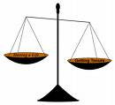
THE FINANCIAL BALANCE IN THE COMPANY: BALANCE SHEET
Balance sheet
is a "photograph" of the set of rights and obligations that the company has at any given time.

Slide 113
BALANCE SHEET
LEFT SIDE What I have: goods and rights
RIGHT SIDE What I owe: obligations
Non-current active (Investments)
Net Equity (contribution from partners)
A=NE+L
Current asset (stocks and collection fees)
Non-current liabilities Current liabilities (Debts)

Slide 114
THE FINANCIAL BALANCE IN THE COMPANY: BALANCE SHEET
Assets
Resources held by the company are called assets or jobs. The balance sheet lists those resources and values them in economic terms.
The balance sheet ranks assets in order of liquidity, starting with those assets that are harder to convert into money and ends up with those that are money.

Slide 115
THE FINANCIAL BALANCE IN THE COMPANY: BALANCE SHEET
Non-current or fixed or immobilized assets long-consuming resources = assets associated with the "investment cycle" its lifespan exceeds the operating cycle.
Material assets: tangible goods Intangible assets: intangible goods Financial assets: permanent financial investments

Slide 116
THE FINANCIAL BALANCE IN THE COMPANY: BALANCE SHEET
Current or circulating active: fast-consumption resources = assets linked to the "operating cycle". They are consumed in the process of acquiring materials, production, marketing and collection of finished products.
Stock: raw materials, ongoing or semi-finished products, finished products, goods.
Short-term performable: accounts that reflect collection rights, mainly from customers.
Available: treasury and bank accounts.

Slide 117

THE FINANCIAL BALANCE IN THE COMPANY: BALANCE SHEET
The right side of the balance sheet, consisting of Net Equity and Liabilities, reflects where the money used to finance the asset comes from, i.e. which are the sources of financing that were used to make the investments.
Items are sorted according to their enforceability.

Slide 118
THE FINANCIAL BALANCE IN THE COMPANY: BALANCE SHEE
Own Funds, Own Resources or Liability not required
Social capital ("Unlimited" duration)
Reservations (unsused profits)
Exercise results Capital grants
External Resources or Current Liabilities
Long-term debts (period of more than one year)
Short-term debts (less than one year's return)

Slide 119
THE FINANCIAL STRUCTURE: EQUITY
Own resources or own funds, resources that should not be repaid that may be of the following types:
Contributed by the owners (capital social fundamentalmente)
Generated by the company itself or self-financing, who are of two types:
Enrichment (profits withdrawn by homeowners): Reservations
Maintenance (maintain the value of assets): depreciations, provisions, etc.
Capital grants, assimilated to the Own Funds given their non-enforceable character.

Slide 120
THE FINANCIAL STRUCTURE: NON-CURRENT LIABILITIES
Non-long-term resources May be:
Debts and loans: resources requested by the company to a financial institution. We have to consider:
Leasing: is a contract whose exclusive purpose is the transfer of the use of movable or immovable property, acquired for that purpose by the entity according to the specifications of the future user, in exchange for a consideration consisting of the periodic payment of the agreed fees.
Creditors of immobilization
The Repayment Term, over one year Commissions, function of the amount of the loan or credit Interests, function of the type of int. and the amount and operating time. The Depreciation Fees, which represent the return of the principal

Slide 121

THE FINANCIAL STRUCTURE: CURRENT LIABILITIES
Non-Short-Term Resources
These are sources of financial institutions where the maturity (enforceability) is less than one year.
They may have explicit financial cost: Loans, credits, effect discount policies, etc.
Or not have it: Suppliers, Public Finance, Social Security, etc.

Slide 122
S/T FINANCIAL SOLVENCY: THE TREASURY
Sales and collections do not have to match over time, as do purchases and payments; For this reason, it is necessary to develop a budget that allows to control the actual capacity of payment that the company has according to its collections.
Treasury budget Initial balance available
+ Operation Collections
-Operation payments
------------------------------------
=Operating balance
+ Non-exploitation collections
-Non-exploitation payments
-------------------------------------
= Final balance available

Slide 123
LONG-TERM FINANCIAL SOLVENCY
Solvency is the company's ability to meet its payment commitments, both with resources generated by it, and with the assets committed.
AUTONOMY=OWN RESOURCES/TOTAL LIABILITIES
INDEBTEDNESS = TOTAL REQUIRED/LIABILITIES
LIQUIDITY = TREASURY + SHORT-TERM ACHIEVABLE/ TOTAL LIABILITIES
TOTAL SOLVENCY= TOTAL ASSETS/OUTSTANDING LIABILITIES
TECHNICAL SOLVENCY= CIRCULATING ASSETS/ CIRCULATING LIABILITIES
Ratios have no value taken in isolation, should only be formulated and analyzed when it constitutes a coherent set.

Slide 124
REMEMBER: ECONOMIC AND FINANCIAL PROFITABILITY
RETURN ON ASSETS (ROA)
RETURN ON EQUITY (ROE)
Profit/Asset
Profit/Capital
Is it profitable?
Is it worth it?
Do I have the financial capacity to do so?
ROA = Profit margin x Rotation
ROE=ROA x financial appeceament

Slide 125
BREAK-EVEN POINT
These are the sales needed to cover the costs
Income
Expenses
Sales
Fixed costs
Services provided
Variable costs
From that moment on, the company will have BENEFITS

Slide 126
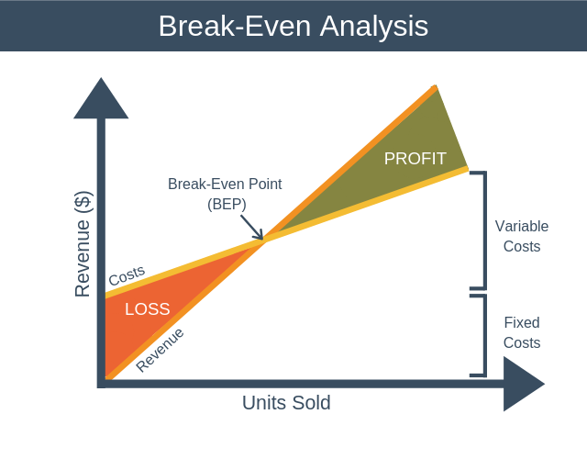
BREAK-EVEN POINT

Slide 127
Módulo 5:
BUSINESS PLAN

Slide 128
BUSINESS PLAN
1. Business idea
What do we want to do?
2. Market
Who are we going to sell?
3. Marketing
How are we going to sell it?
4. Environmental analysis
Who are our competitors?
5. Operations plan
How are we going to produce it?
6. Organization and resources
What and who do we need in our company?
7. Financial economic plan
How much money do we need?
8. Sources of funding
Where can we get the money?
9. Constitution and legal requirements
The company starts-up

